Slide 1
PLANNING COMMISSION
Board of Supervisors Chambers
400 County Center, Redwood City
ITEM 3
Owner: ………………………….
Applicant: ………………………
File Number: .…………………..
Location: ………………………..
APN: …………………….……….
Anusha Thalapaneni and David Jackson
Maurits de Gans, Designer
PLN 2020-00251
634 Palomar Drive, Palomar Park
APN 051-022-380
Project Description:
Construction of a three-story, 4,249 sq. ft. single-family residence, 315 sq. ft. covered terrace, a 155 sq. ft. deck, and a 554 sq. ft. attached garage, on a 18,122 sq. ft. legal parcel.
PLANNING AND BUILDING DEPARTMENT
Notes:
1

Slide 2
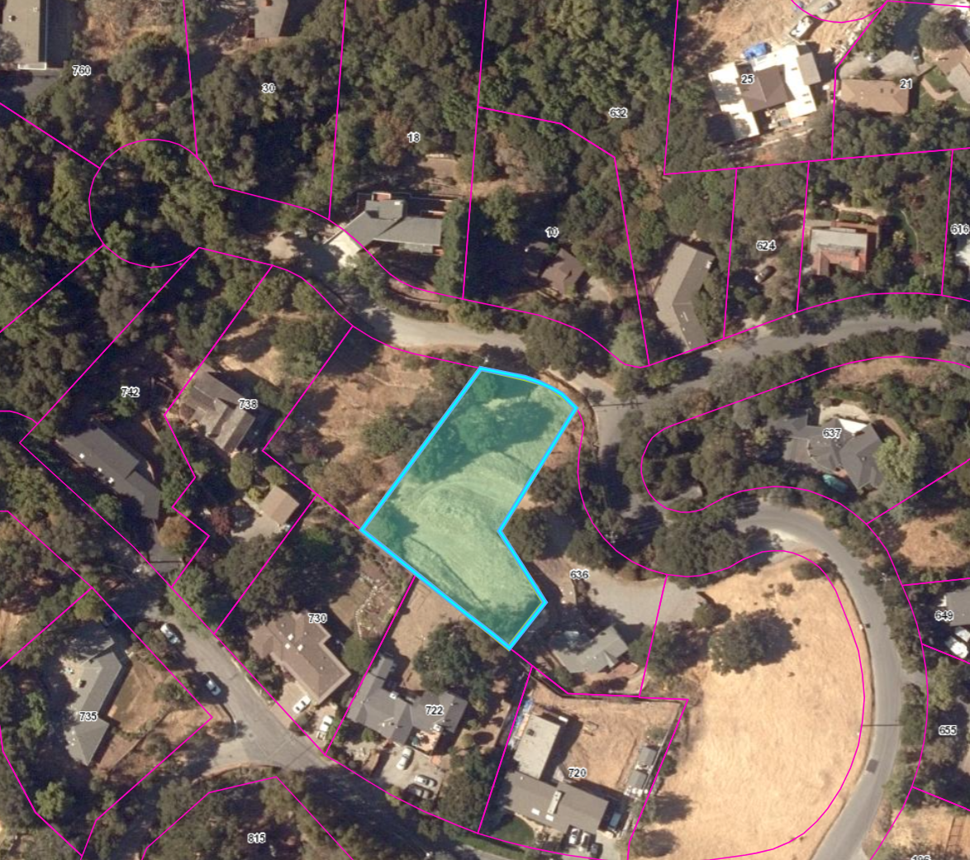
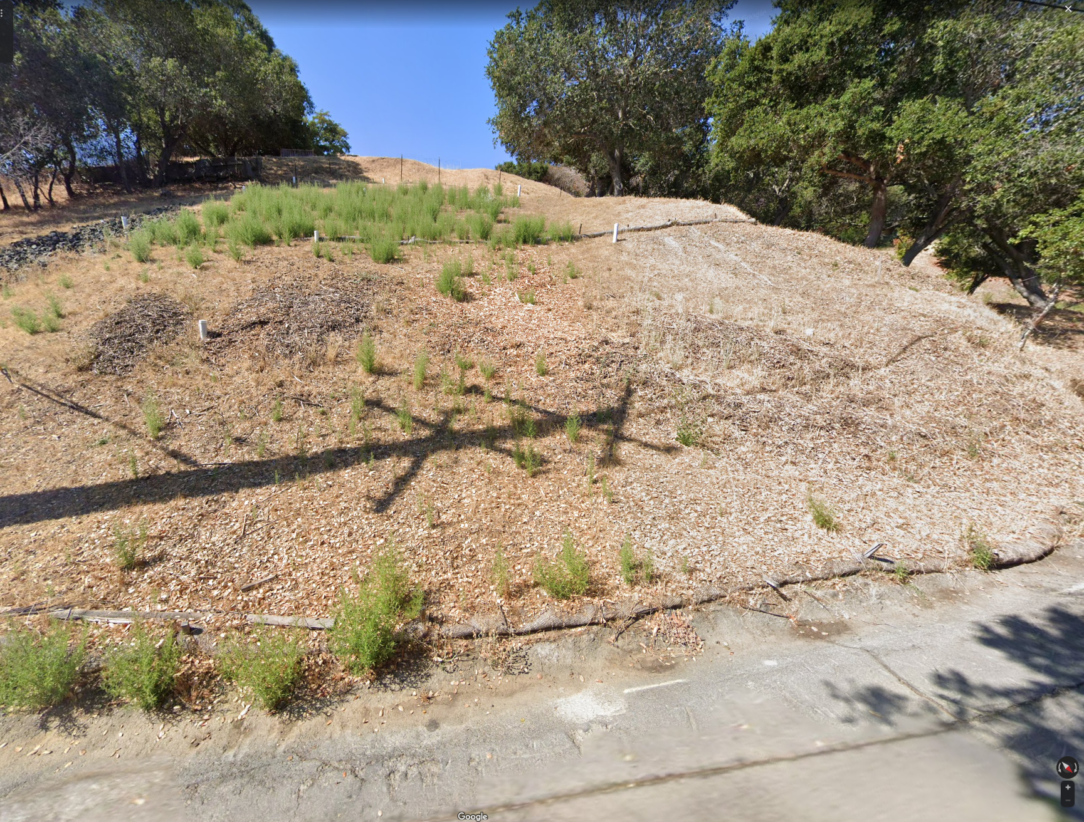
Insert photos or plans
Undeveloped parcel qt Los Cerros Road and Palomar Drive

Slide 3
PROJECT DESCRIPTION
New 4,249 sq. ft., three-story residence on a 18,122 sq. ft. legal parcel.
Project access is from an improved existing gravel driveway located on 636 Palomar Drive and APN 051-022-250.
The project involves 880 cubic yards (c.y.) of cut and 90 c.y. of fill and the removal of 2 significant trees.
Zoning: R-1/S-91/DR (Minimum Lot Size 10,000 sq. ft.)
PLANNING AND BUILDING DEPARTMENT
Notes:
3

Slide 4
PLANNING COMMISSION HEARING OF MAY 8, 2023
Members of the public expressed concerns regarding potential project impacts, mainly concerns regarding site stability, due to a history of land sliding in the area which could be exacerbated by project construction, site drainage, and septic system construction, as well as proposed tree removal.
Mark Haesloop (on behalf of Denise Enea Charlebois at 738 Loma Court), and Barry Hecht from Balance Hydrologics presented a letter, dated March 7, 2023, including analysis pertaining to site hydrology, past land sliding in the area, and concerns regarding potential land instability resulting from project grading.
Action: Planning Commission continued its review of the project to a date uncertain to allow time for the applicant’s team and County staff to review the Balance Hydrologics Letter.
PLANNING AND BUILDING DEPARTMENT
Notes:
4

Slide 5
County Review of Additional Documentation
County Review of Balance Hydrologics Letter:
Cotton Shires and Associates (County’s Geotechnical Consultant) finds that there is no new information that would compel us to modify our opinion that the Project Geologist and Geotechnical Engineer have: 1) investigated the site in accordance with the standards of practice in the County, 2) identified the significant geologic and geotechnical hazards at the site; 3) recommended suitable mitigation measures to address those hazards; and 4) adequately addressed CSA’s previously provided comments and concerns”.
No New Landslides:
In a letter dated April 5, 2023, Denise Enea Charlebois notified the Property Owners of 634 Palomar Drive, regarding emergency measures taken under a building permit at 738 Loma Court, including installation of subdrain lines, in response to 2 potential new landslides. No information from a geotechnical or engineering professional was submitted
Based on staff’s review of these documents, staff has concluded that there is no formal documentation or evidence of any potential new landslides.
PLANNING AND BUILDING DEPARTMENT
Notes:
5

Slide 6
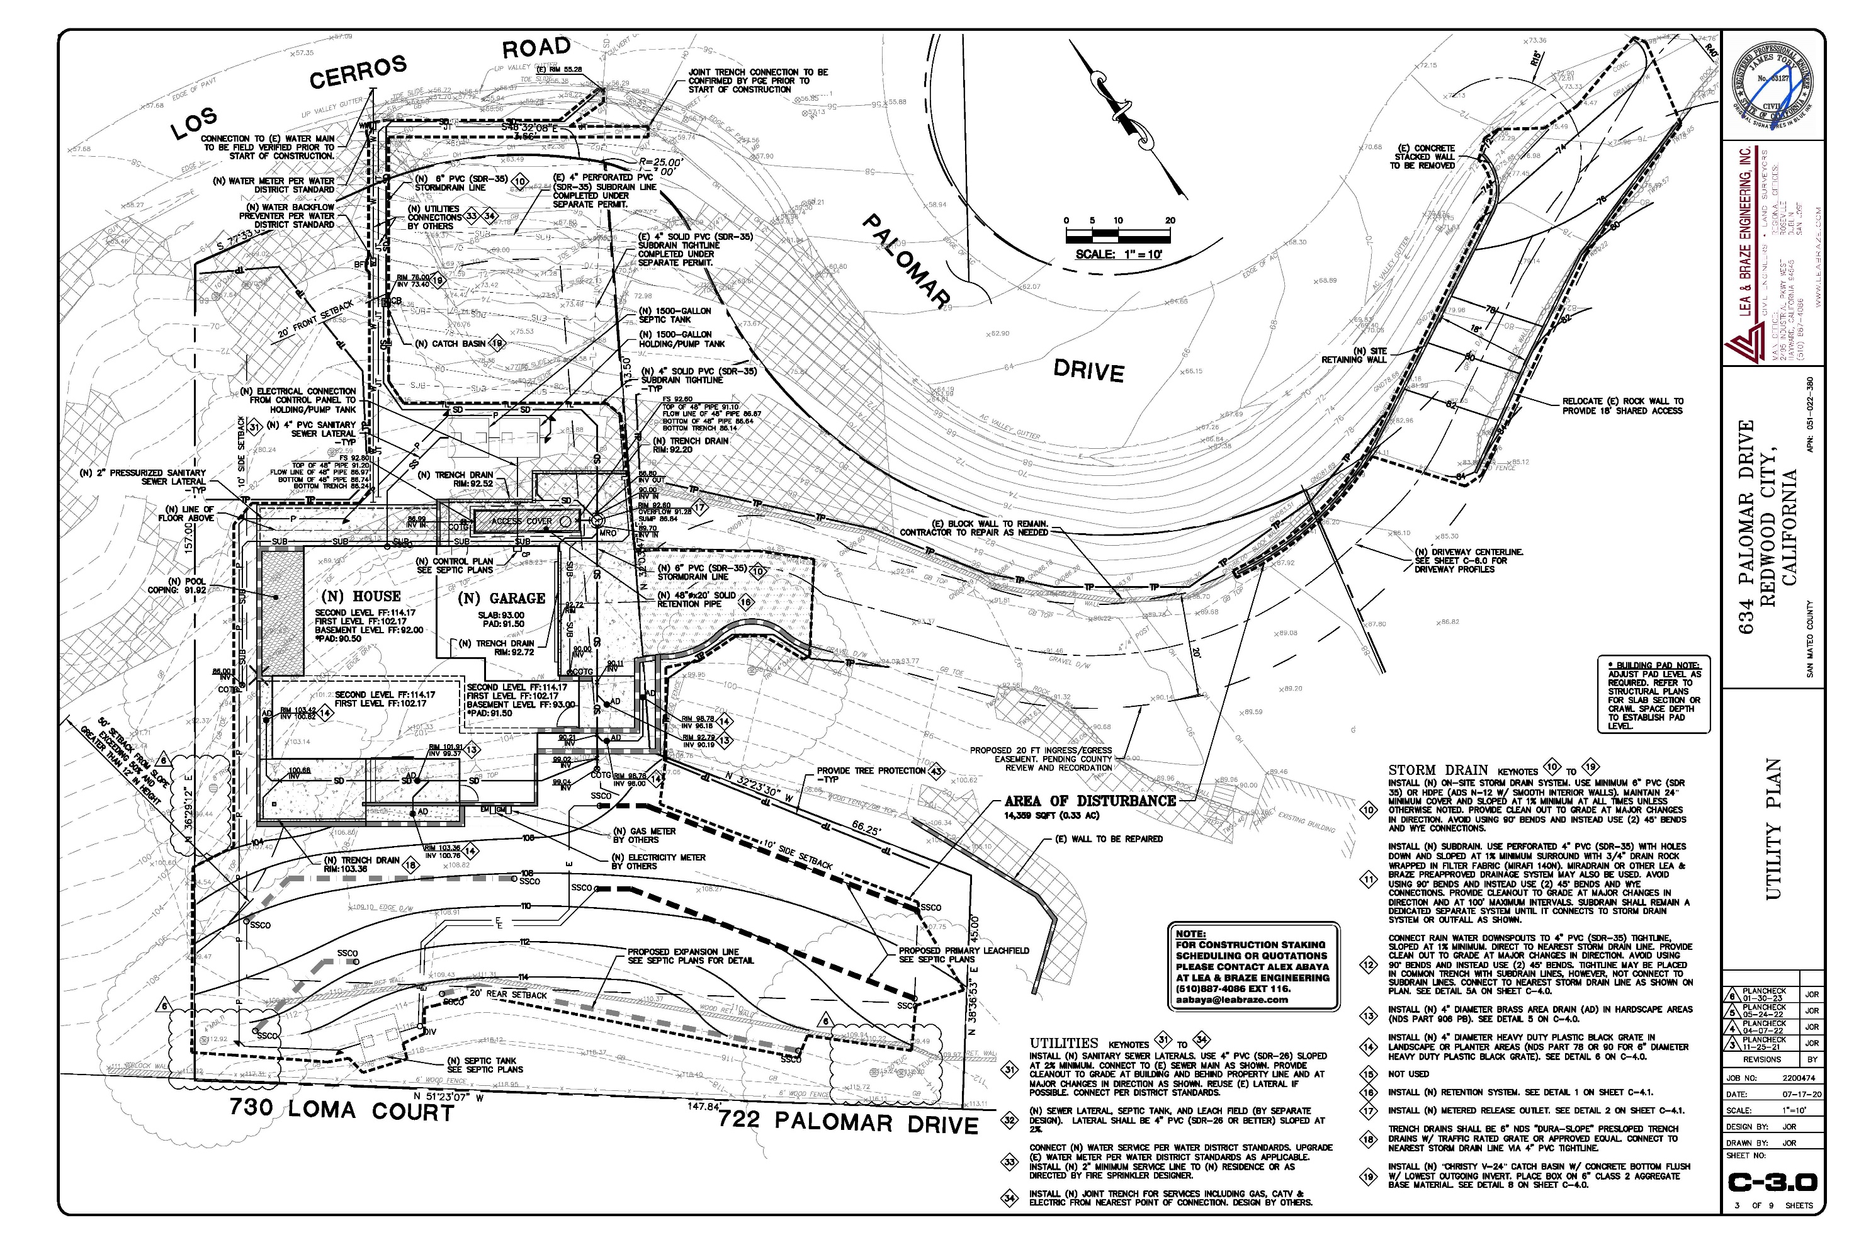
Gravel
concrete
Proposed Septic System

Slide 7
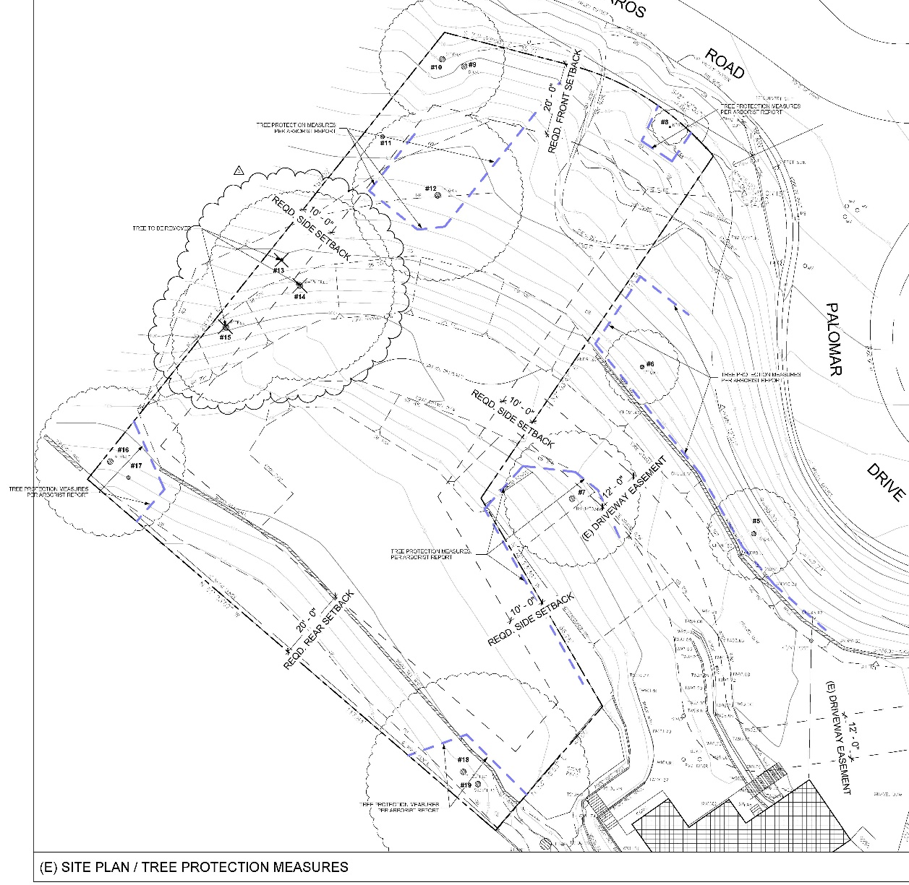
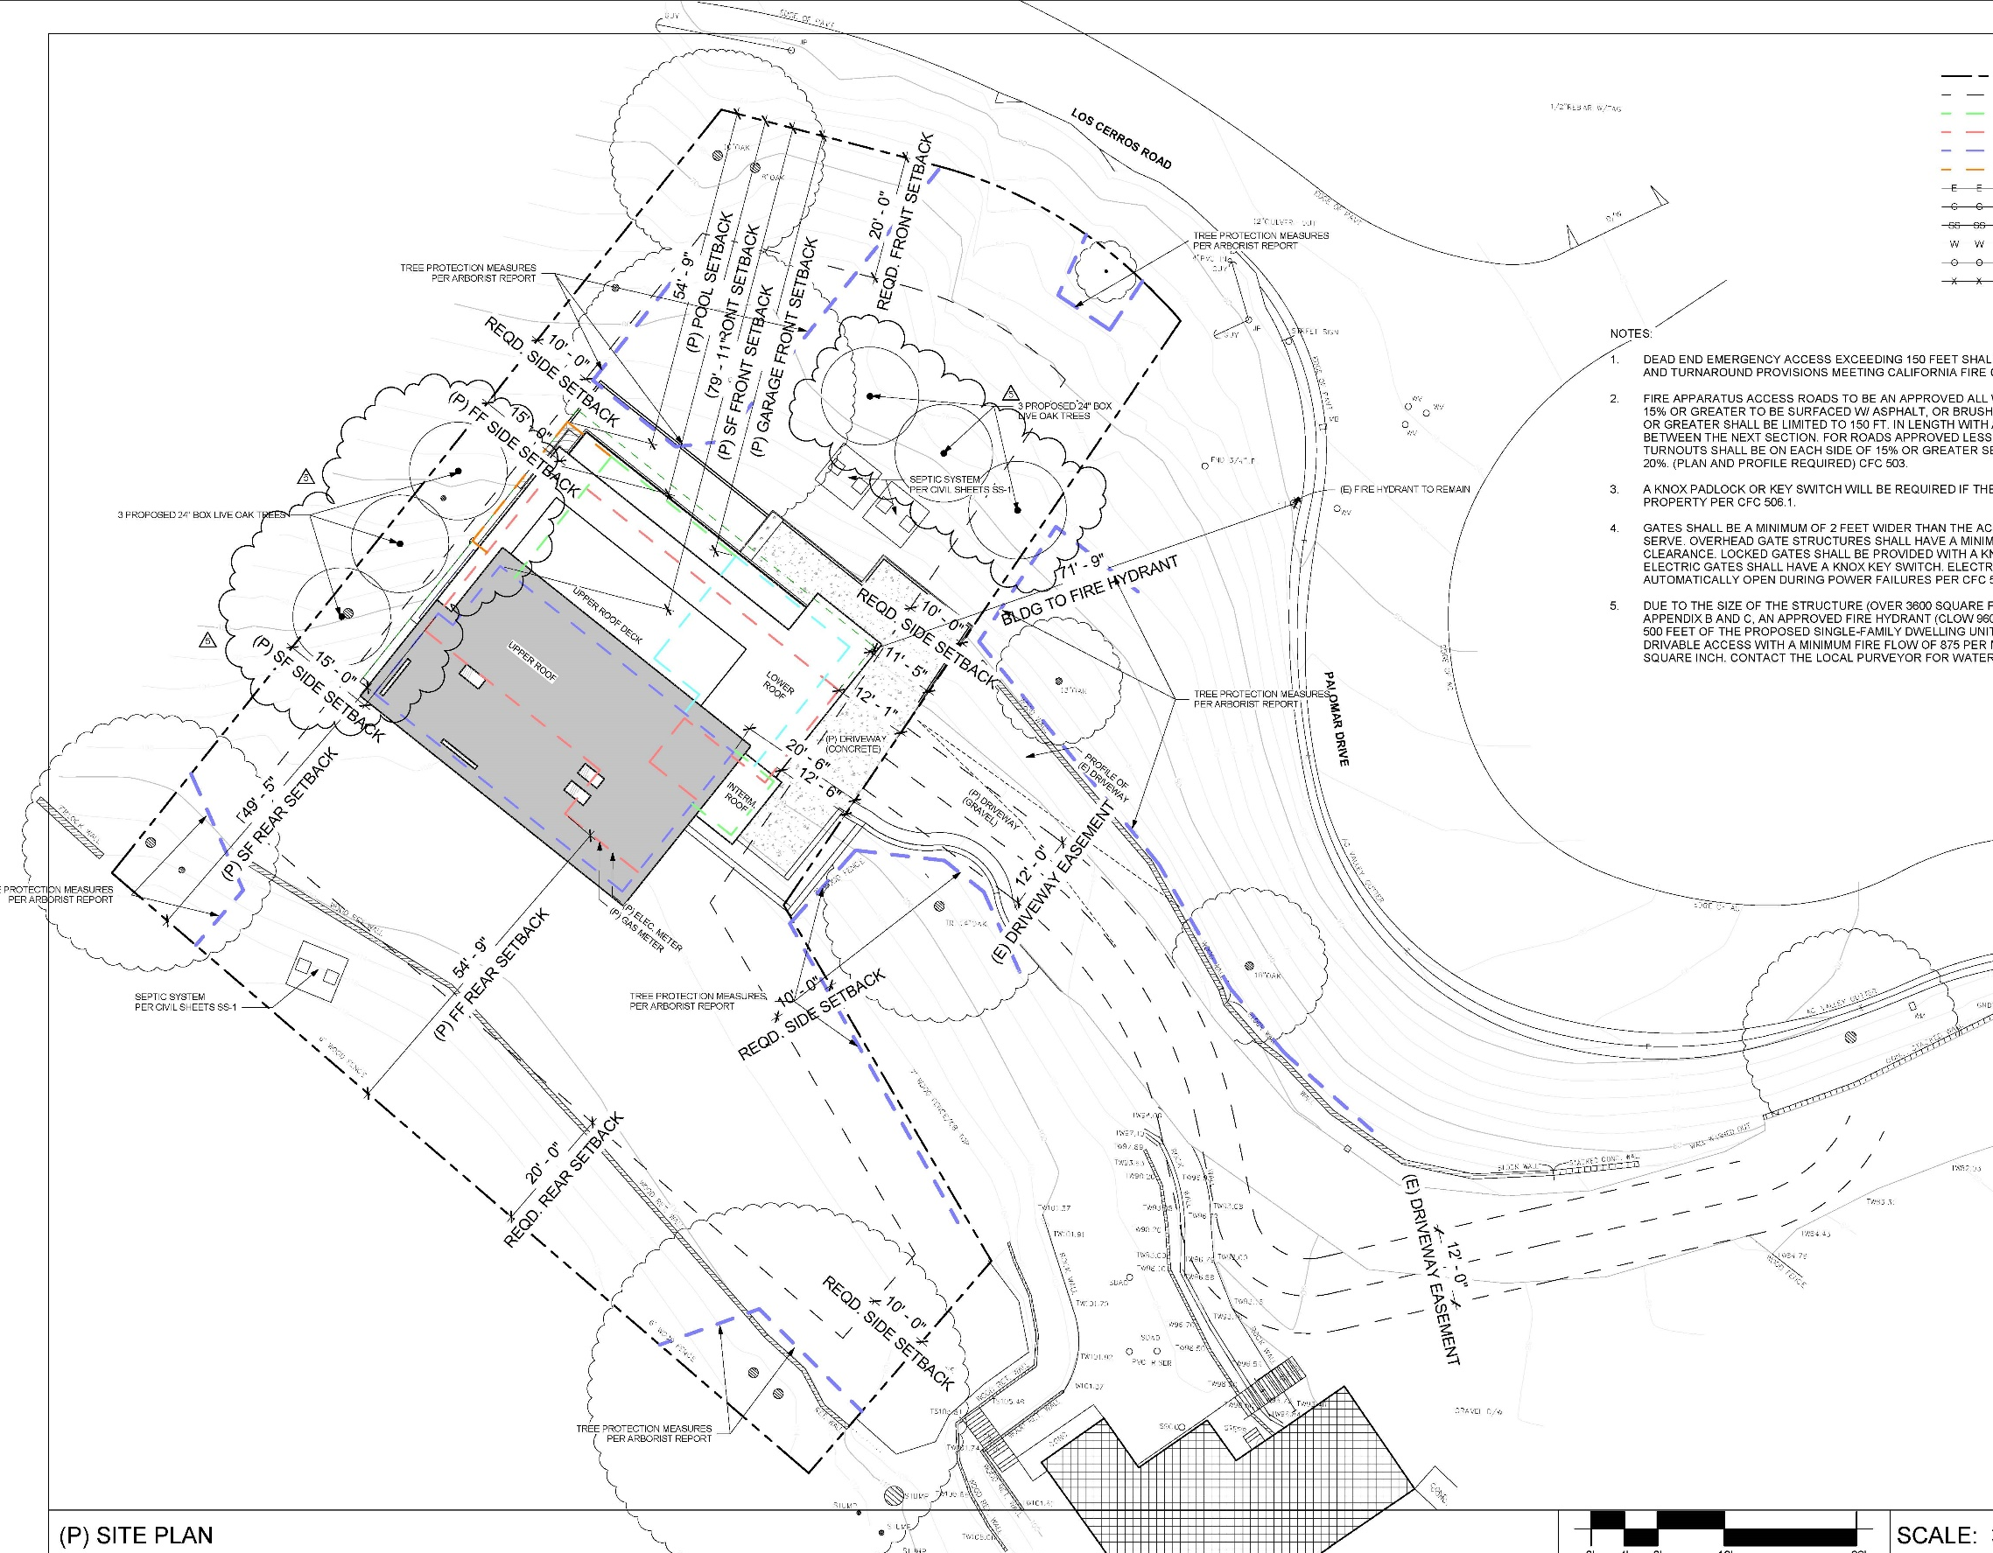
Applicant required to replace the three (3) indigenous trees with a minimum of three (3), 24-inch box Oak trees
Removal of 2 significant trees (21”/17.5” Coast Live Oak and 10/6.4” Buckeye) and a 5.14-inch California bay tree

Slide 8
2nd Floor: 1,340 s.f.
523 s.f.
1st Floor: 2,022 s.f., plus 215 s.f. deck
Base Floor: 1,041 s.f. includes garage

Slide 11
REGULATIONS CONFORMANCE
Design Review District Guidelines: On October 26, 2022, the Bayside Design Review Committee (CDRC) reviewed and recommended approval of the project.
The project is in compliance with design standards in terms of materials and colors; pitched roofs; lighting; and site planning to minimize alteration of the natural topography, respect the privacy of neighboring houses and outdoor living areas, and minimize tree removal.
The BDRC required further reduction in the use of glass on the eastern and northern facades and change to roof design, included as Condition 3, as well as to minimize tree removal which has been complied with.
The applicant has revised the proposal to remove only 2 significant trees.
PLANNING AND BUILDING DEPARTMENT
Notes:
11

Slide 12
REGULATIONS CONFORMANCE
Required Findings for Grading Permit:
That the granting of the permit will not have a significant adverse effect on the environment, comply with Grading Regulations, and Comply with General Plan.
Applicant must comply with standard conditions of approval which will require:
Excavated earth to be off-hauled and deposited to an approved disposal location,
Application of erosion control measures prior to and during project grading and construction,
Limit grading during the wet season, and
Requires Project Engineer shall submit written certification that all grading has been completed in conformance with the approved plans
PLANNING AND BUILDING DEPARTMENT
Notes:
12

Slide 13
California Environmental Quality Act (CEQA) Compliance
An Initial Study/Mitigated Negative Declaration was prepared and circulated for public review from July 2, 2022, to July 22, 2022.
The County received two (2) comment letters, including a letter from the Palomar Park Owners’ Association, expressing concern with the land stability, drainage, house size and design, and trees to be removed, amongst other concerns.
Main Concerns
Geology:
A letter from Denise Enea states that the IS/MND underplays and leaves out critical information regarding the long history of landslides on and directly adjacent to this parcel. Ms. Enea references letters from Kilik General Engineering, GeoForensics, Inc., and Jeff Lea of Lea & Braze, which are included and analyzed in the IS/MND.
PLANNING AND BUILDING DEPARTMENT
Notes:
13

Slide 14
California Environmental Quality Act (CEQA) Compliance
The referenced letters reflect brief reviews of the adjoining off-site properties, with no enclosed maps and no mention of specific site locations or the site APN. The 2021 Connelly report includes a general geologic review of the subject site and does not include subsurface exploration and testing.
The applicant has submitted comprehensive, site-specific reports, including subsurface exploration and testing, for the proposed residence and septic system, which have been reviewed by and received preliminary approval from the County Environmental Health Services and the County’s Geologist and Geotechnical Engineer. Staff’s recommendation of approval is based on the analysis and conditions of approval recommended in those reports.
Hydrology: Ms. Enea asserts that groundwater and springs are the basis for instability of the parcels in this area. Based on subsurface exploration and testing, there is no evidence to support a conclusion that pervasive springs exist on the project site.
PLANNING AND BUILDING DEPARTMENT
Notes:
14

Slide 15
California Environmental Quality Act (CEQA) Compliance
Trees: Initially, project proposed removal of seven (7) significant trees, which commenters stated could result in negative aesthetic impacts and impact the stability of the property, due to the stabilization and drainage benefits provided by the root systems of the trees. The applicant has revised the proposal to remove only 2 significant trees (Trees 14 and 15) and a 5.14-inch California bay tree (which is not a significant tree).
Applicant required to replace the three (3) indigenous trees with a minimum of three (3), 24-inch box Oak trees. The applicant proposes to plant these trees in the right-side setback to provide screening of the residence in the same location as the above listed trees proposed for removal. Three (3) additional 24” box trees will also be planted on the lower slope.
PLANNING AND BUILDING DEPARTMENT
Notes:
15

Slide 16
RECOMMENDATION AND FINDINGS
That the Planning Commission:
That the Planning Commission adopt the Initial Study/Mitigated Negative Declaration, and approve the Design Review Permit and Grading Permit, by making findings and adopting the conditions of approval in Attachment A.
PLANNING AND BUILDING DEPARTMENT
Notes:
16

Slide 17
PLANNING COMMISSION
Board of Supervisors Chambers
400 County Center, Redwood City
ITEM 3
Owner: ………………………….
Applicant: ………………………
File Number: .…………………..
Location: ………………………..
APN: …………………….……….
Anusha Thalapaneni and David Jackson
Maurits de Gans, Designer
PLN 2020-00251
634 Palomar Drive, Palomar Park
APN 051-022-380
Project Description:
Construction of a three-story, 4,249 sq. ft. single-family residence, 315 sq. ft. covered terrace, a 155 sq. ft. deck, and a 554 sq. ft. attached garage, on a 18,122 sq. ft. legal parcel.
PLANNING AND BUILDING DEPARTMENT
Notes:
17

Slide 18
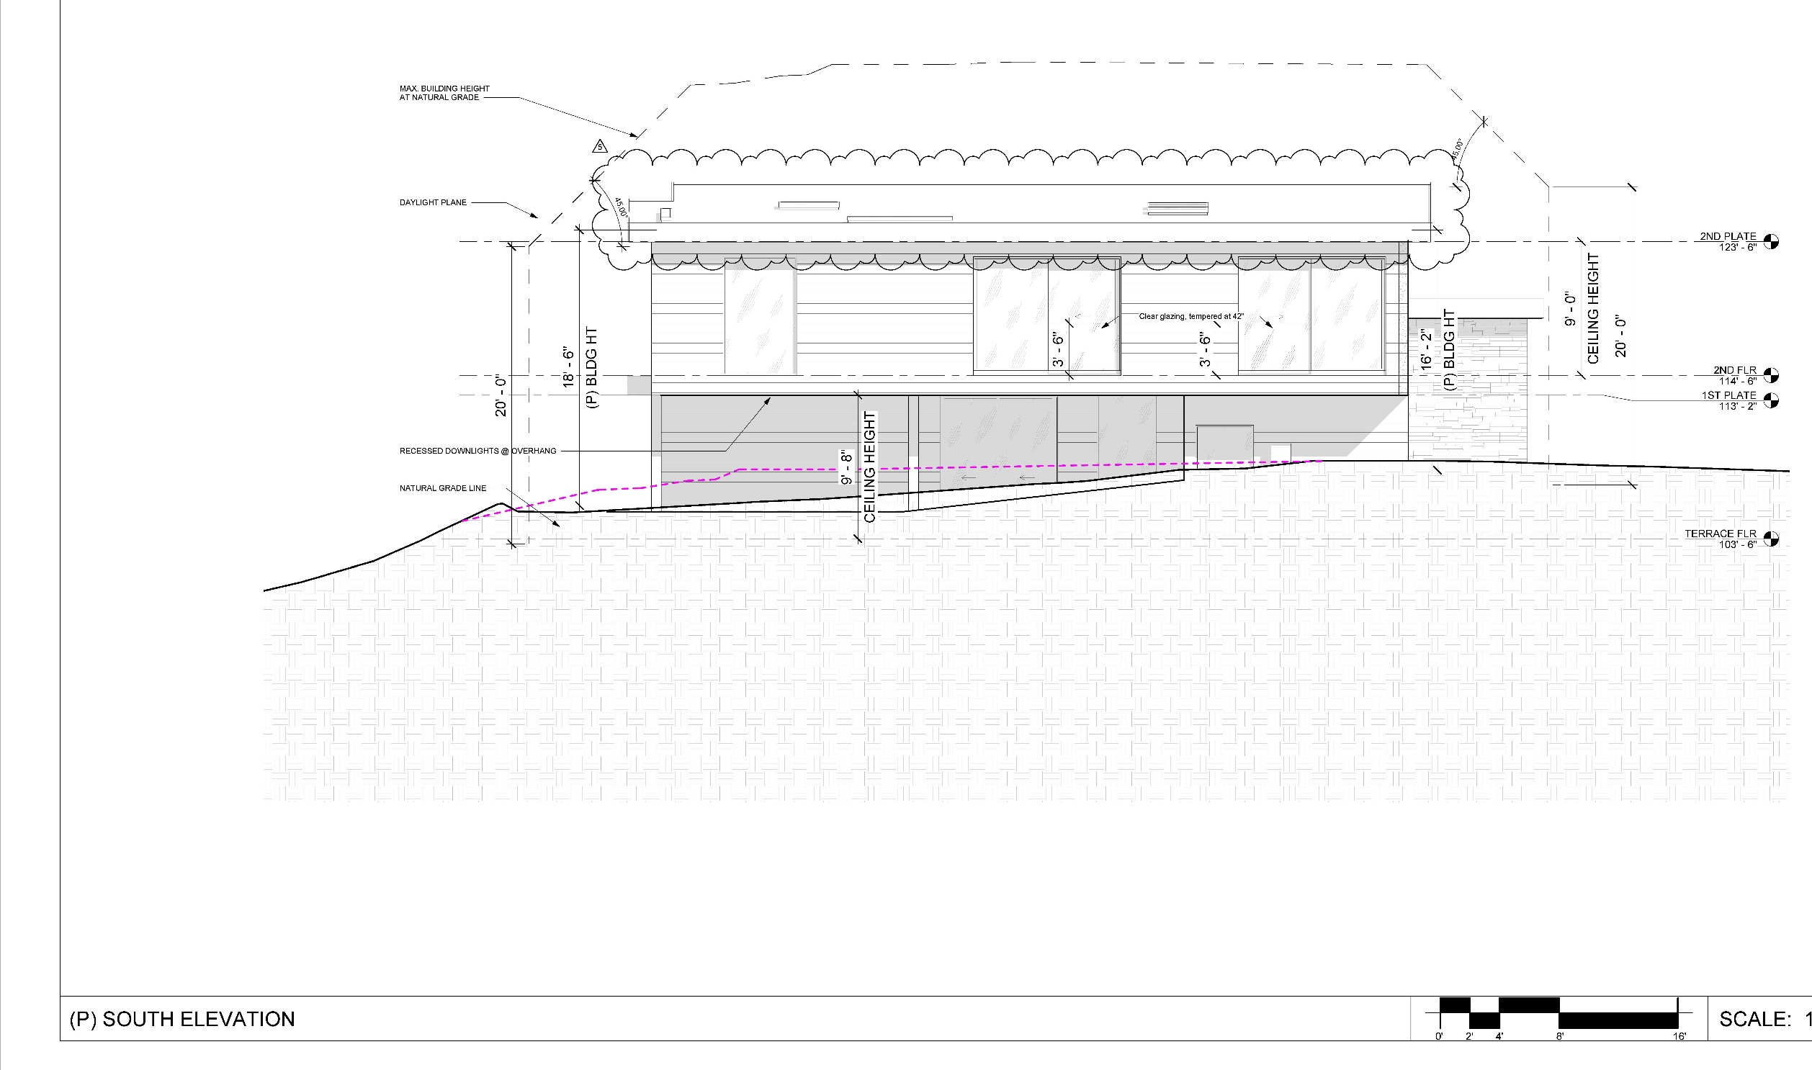
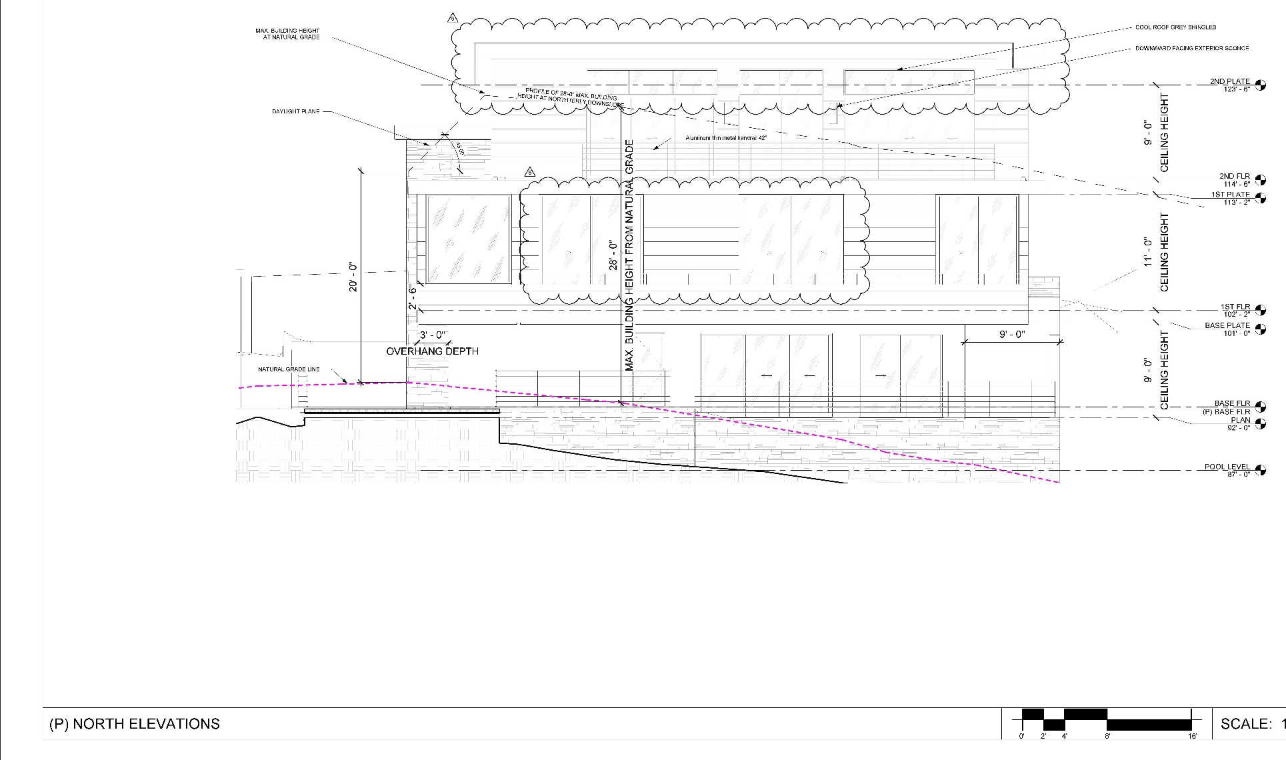

Slide 19
